Slide 1

Software Testing Overview

Slide 2
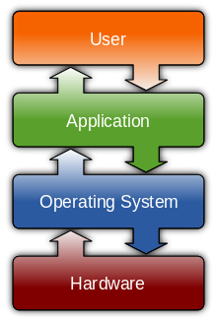
What is a software?
Software is a general term for the various kinds of programs used to operate computer and related devices.
Software development is:
+ Documenting
+ Computer programming
+ Testing
+ Bug fixing (Maintain)

Slide 3
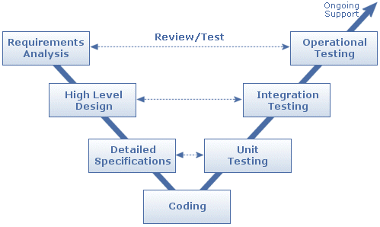
What is Software testing?
Is a process of executing a program or application with the intent of finding software bugs (ISTQB)
Types of Testing:
+ Unit Testing (developers)
+ Functional Testing
+ Integration Testing
+ System Testing
+ Regression Testing
+ Acceptance Testing

Slide 4
Importance of Software Testing
Software testing is really required to point out the defects and errors that were made during the development phases.
It’s essential since it makes sure of the Customer’s reliability and their satisfaction in the application.
It is very important to ensure the Quality of the product.
Testing is necessary in order to provide the facilities to the customers like the delivery of high quality product or software application which requires lower maintenance cost and hence results into more accurate, consistent and reliable results.
Testing is required for an effective performance of software application or product.
It’s important to ensure that the application should not result into any failures because it can be very expensive in the future or in the later stages of the development.
It’s required to stay in the business.

Slide 5


Roles and Responsibilities of a Tester?
Analyzing the Requirements from client
Reviewing documents, contributing to test plan
Setting up test environment
Creating and Maintaining Test cases
Executing test cases
Finding bugs then logging bugs
Tracking Defects
Communication with Test Lead/ Test Manager/ Other Testers/ Developers/
Reporting about defects and test results

Slide 6
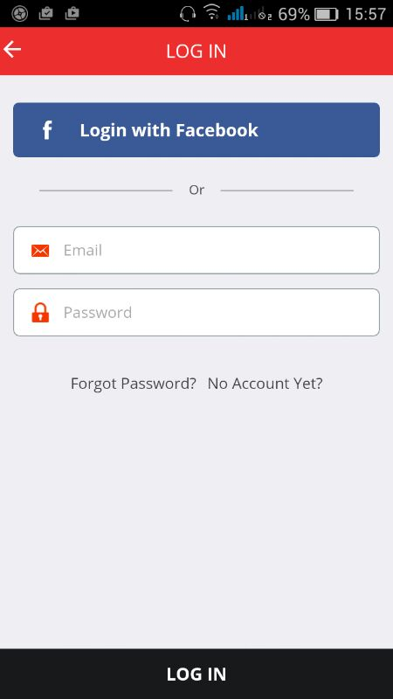
An Example of Testing
What if user does not input email/ password?
What if user inputs correct/ wrong email/ password?
What if user inputs 5000 characters into email/ password field?
What if user inputs non email format into Email field?
What happen if user clicks to Forgot Password? No Account Yet?

Slide 7
Q&A

